Slide 1
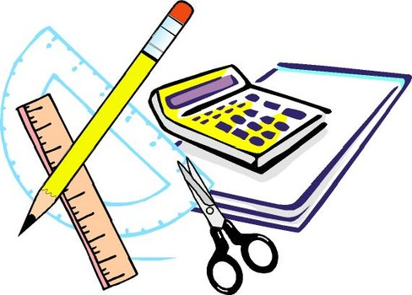
Learning Objective
I will solve probability problems with conditions applied.
Enter quietly, please be ready with the following on your desk:
Whiteboard
Whiteboard marker
Exercise Book
Pencil, pen, ruler and red pen
Diary
Calculator
Device – charged or borrowed from Library before maths

Slide 2
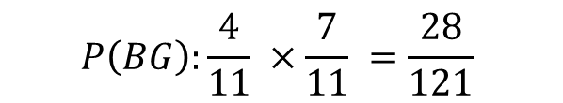
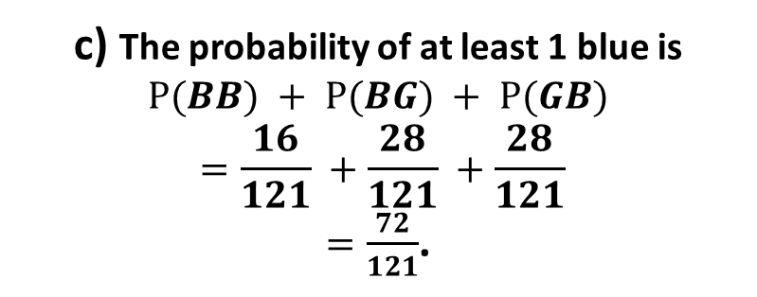

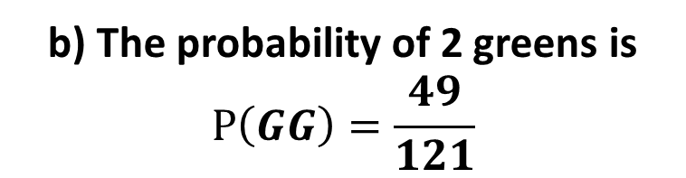
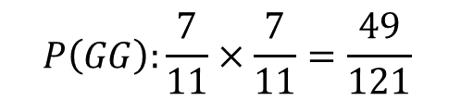

Daily Review
A marble is taken from a bag containing 4 blue marbles and 7 green marbles. It is replaced and then a 2nd marble is taken out.
Draw a tree diagram that represents this situation
Find the probability of getting two green marbles.
Find the probability of getting at least one blue marble.
‘with replacement’
<
1st
2nd
b) The probability of 2 greens is
$$P\left(GG\right)=\frac{49}{121}$$
<
$$P\left(BB\right):\frac{4}{11}×\frac{4}{11} =\frac{16}{121}$$
B
4/11
4/11
B
<
G
$$P\left(BG\right):\frac{4}{11} ×\frac{7}{11} =\frac{28}{121}$$
7/11
c) The probability of at least 1 blue is
$$P(BB) + P⁡(BG) + P⁡(GB)$$
$$=\frac{16}{121} +\frac{28}{121} +\frac{28}{121}$$
$=\frac{72}{121}$.
B
$$P\left(GB\right):\frac{7}{11} ×\frac{4}{11} =\frac{28}{121}$$
4/11
7/11
G
7/11
G
$$P\left(GG\right):\frac{7}{11}×\frac{7}{11}=\frac{49}{121}$$

Slide 3
Daily Review
A marble is taken from a bag containing 4 blue marbles and 7 green marbles. It is not replaced before a 2nd marble is taken out.
Draw a tree diagram that represents this situation
‘without replacement’
<
1st
2nd
<
B
After we take one marble out, there are only 10 marbles left.
If the 1st marble was blue, there are only 3 blue marbles left.
If the 1st marble was blue, there are still 7 green marbles left.
3/10
4/11
B
<
G
7/10
B
4/10
7/11
G
If the 1st marble was green, there are still 4 blue marbles left.
If the 1st marble was green, there are only 6 green marbles left.
6/10
G

Slide 4

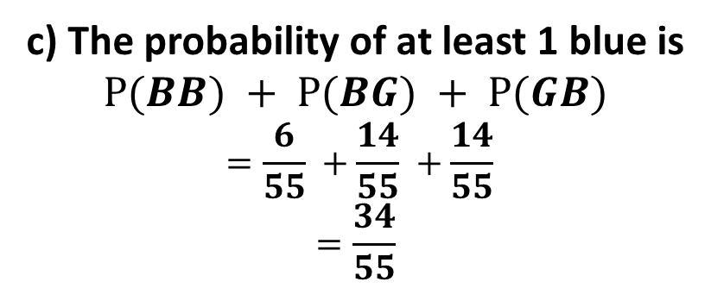

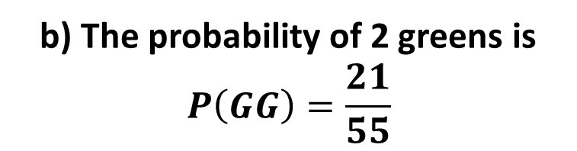

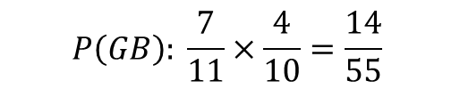
Daily Review
A marble is taken from a bag containing 4 blue marbles and 7 green marbles. It is not replaced before a 2nd marble is taken out.
a) Draw a tree diagram that represents this situation.
b) Find the probability of getting two green marbles.
c) Find the probability of getting at least one blue marble.
‘without replacement’
<
1st
2nd
<
b) The probability of 2 greens is
$$P\left(GG\right)=\frac{21}{55}$$
$$P\left(BB\right): \frac{4}{11} ×\frac{3}{10} =\frac{6}{55}$$
B
3/10
4/11
B
<
G
$$P\left(BG\right): \frac{4}{11}×\frac{7}{10} =\frac{14}{55}$$
7/10
c) The probability of at least 1 blue is
$$P⁡(BB) + P⁡(BG) + P⁡(GB)$$
$$=\frac{6}{55} +\frac{14}{55} +\frac{14}{55}$$
$$=\frac{34}{55}$$
B
$$P\left(GB\right): \frac{7}{11}×\frac{4}{10}=\frac{14}{55}$$
4/10
7/11
G
6/10
G
$$P\left(GG\right):\frac{7}{11}×\frac{6}{10}=\frac{21}{55}$$

Slide 5
Daily Review
Two cards are drawn, without replacement, from a set of 20 cards that are numbered 1 to 20.
Let P = ‘a prime number is drawn’ and N = ‘a prime number is not drawn’.
Draw a tree diagram to show this information.
Prime numbers between 1 and 20 are 2, 3, 5, 7, 11, 13, 17, 19 (eight in total).
<
1st
2nd
<
P
After we take one card, there are only 19 cards left.
If the 1st card was prime, there are only 7 primes left.
If the 1st card was prime, there are still 12 non-primes left.
7/19
8/20
P
<
N
12/19
P
8/19
If the 1st card wasn’t prime, there are still 8 primes left.
If the 1st card wasn’t prime, there are only 11 non-primes left.
12/20
N
11/19
N

Slide 6





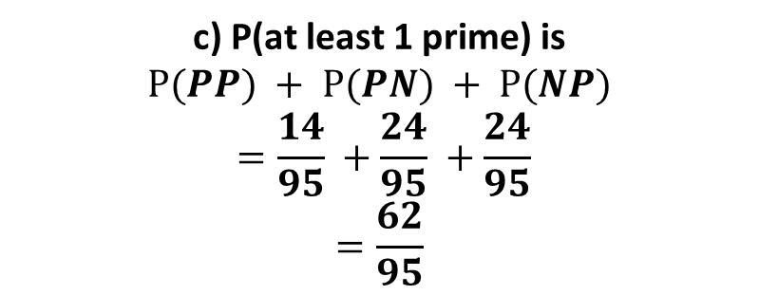

Daily Review
Two cards are drawn, without replacement, from a set of 20 cards that are numbered 1 to 20.
Let P = ‘a prime number is drawn’ and N = ‘a prime number is not drawn’.
Find Pr(both cards are prime)
Find Pr(no cards are prime)
Find Pr(at least one card is prime)
<
a) Pr(both prime) is
$P\left(PP\right)=\frac{14}{95}$.
1st
2nd
<
$$P\left(PP\right)=\frac{8}{20}×\frac{7}{19}=\frac{14}{95}$$
P
7/19
b) P(no primes) is
$P\left(NN\right)=\frac{33}{95}$.
8/20
P
<
$$P\left(PN\right)=\frac{8}{20}×\frac{12}{19}=\frac{24}{95}$$
N
12/19
$$P\left(NP\right)=\frac{8}{20}×\frac{12}{19}=\frac{24}{95}$$
c) P(at least 1 prime) is
$$P⁡(PP) + P⁡(PN) + P⁡(NP)$$
$$=\frac{14}{95} +\frac{24}{95} +\frac{24}{95}$$
$$=\frac{62}{95}$$
P
8/19
12/20
N
$$P\left(NN\right)=\frac{12}{20}×\frac{11}{19}=\frac{33}{95}$$
11/19
N

Slide 7
Learning Objective
CFU 1
What will we learn?
I will be able to solve probability problems with conditional statements
CFU 2
What will we learn?
Success Criteria
I will be able to calculate probabilities with a given conditional statement.

Slide 8
Concept Development
Conditional probability refers to situations where a condition reduces the number of possibilities for an event to occur. For example:
If a standard 6 sided die was rolled, what is the probability that it landed on a 6?
$\frac{1}{6}$ , as there are 6 possibilities with only 1 option being 6.
If a standard 6 sided die was rolled, what is the probability that it landed on a 6 given that it landed on an even number?
$\frac{1}{3}$ , as there are 3 even possibilities with only 1 option being 6.
In the second situation, the condition was that the die has landed on an even number. This reduced the number of possible outcomes.

Slide 9
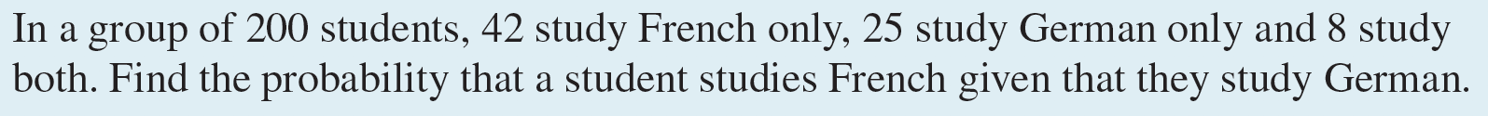
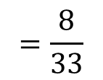
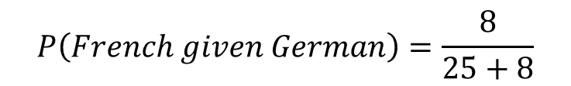
Concept Development
Draw a Venn Diagram to show this information
$$P\left(French given German\right)=\frac{8}{25+8}$$
$$=\frac{8}{33}$$

Slide 10
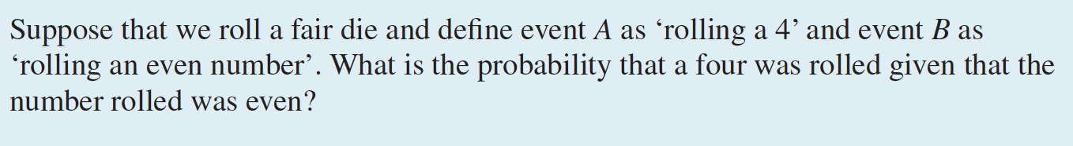

Concept Development
Draw a Venn Diagram to show this information
$$P\left(4 given even\right)=\frac{1}{3}$$

Slide 11
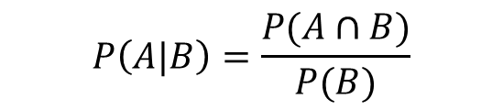

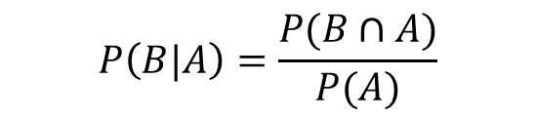

Guided Practice
A 16-sided die with faces numbered 1-16 is rolled. The following events are defined.
A= “number rolled is less than 9”, B = “number rolled is a multiple of 3”
Draw a Venn diagram to represent the information
Calculate the probability when a number rolled is less than 9 given it is a multiple of 3
Calculate the probability when a number rolled is a multiple of 3, given that the number is less than 9.
$$P\left(A|B\right)=\frac{P(A∩B)}{P(B)}$$
$$=\frac{2}{5}$$
$$P\left(B|A\right)=\frac{P(B∩A)}{P(A)}$$
$$=\frac{2}{8}=\frac{1}{4}$$

Slide 12
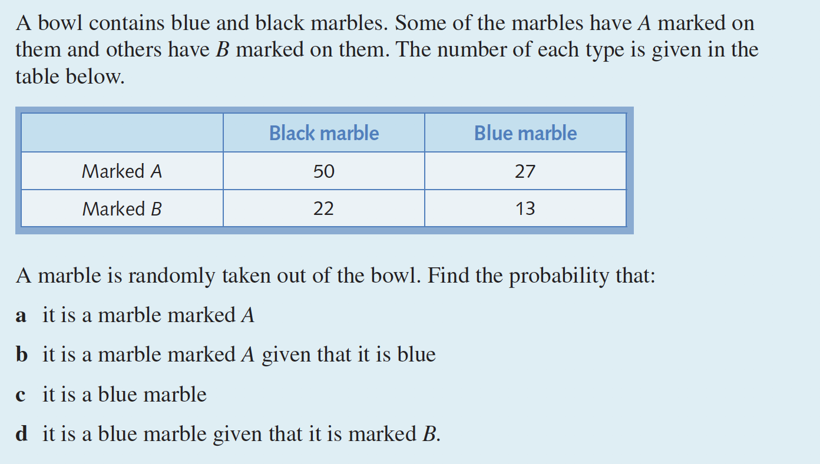
Guided Practice

Slide 13


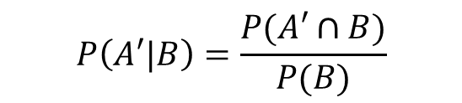
Guided Practice
In a particular electorate, 65% of the voting population do not own a property. It is also known that 55% of property-owners support the Progressive Conservatives Party, but only 40% of the non-property owners support this party.
Construct a 2-way table to represent this information
Find the probability that a randomly selected voter from this electorate does not own property given that they support the Progressive Conservative Party.
$$P\left(A′|B\right)=\frac{P(A′∩B)}{P(B)}$$
$$=\frac{0.26}{0.4525}$$
$$=0.57$$

Slide 14
Independent Practice
Independent Practice
Pearson Ex 10.5 Q 1 to 10

